Slide 1
KYTC D3 Incident Mgt Meeting
Tuesday
03/12/2012

Slide 2
Incident Review
November 29th Natcher Pkwy MP 10 SB
Driver fell asleep, woke up very close to back of a semi, jerked the wheel, overturned in the median and landed on the passenger side. Escaped through driver’s side window and vehicle began to burn. Possible head injuries

Slide 3
Tues, Dec 18th 12pm US 68/Bypass Russellville Semi was preparing to make a right turn onto the bypass and a pin broke, causing the 65 ton steel bridge to fall into the roadway. Was loaded back onto unit 1 for transport.

Slide 4
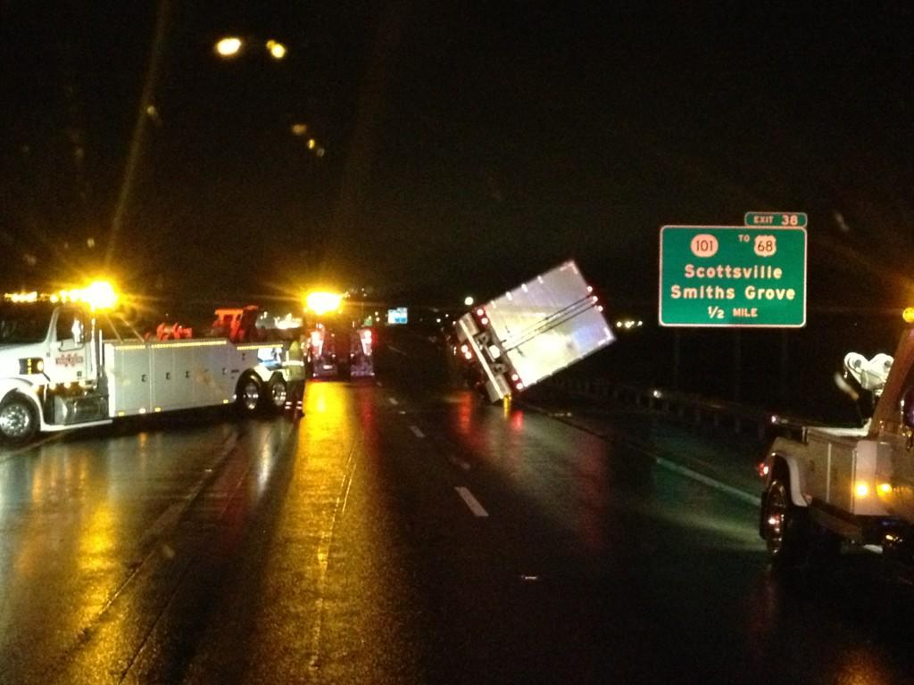
Jan 30th I 65 MP 38 SB Straight Line Winds/F2 Tornado? Driver veered to left barrier, hit the barrier overturned on passenger side then skid across 3 lanes

Slide 5
D3/D4 Detour Plan for Major Incidents
I-65 widening between Horse Cave and Cave City will not be completed until late 2014
For complete closure of the interstate both north and south directions that is greater than 2 hrs
Official detour will be local and if message boards are activated, the boards will display the location (MP) of the accident and advise motorists to take WK to Natcher Pkwy if SB and Natcher Pkwy to WK if NB, flip down signs activated
Split Detour will keep one lane open NB on 31W and one lane open SB on 31E for other emergencies and allow tow operators and other responders to access the scene
For minor incidents < 2 hrs just use 31W for both directions
Incident Duration/Detour Route is at the discretion of the Incident Commander and implemented by KYTC personnel

Slide 6
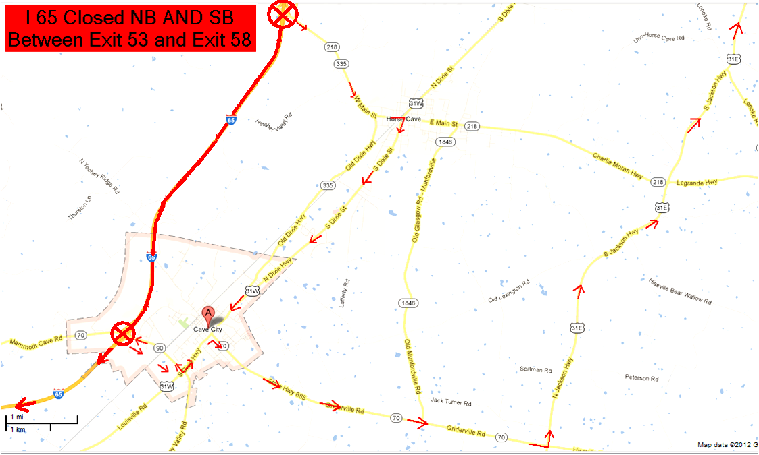
I 65 Closed Both Directions between Exit 53 and Exit 58

Slide 7
Cave City Detour

Slide 8
Cave City Detour

Slide 9
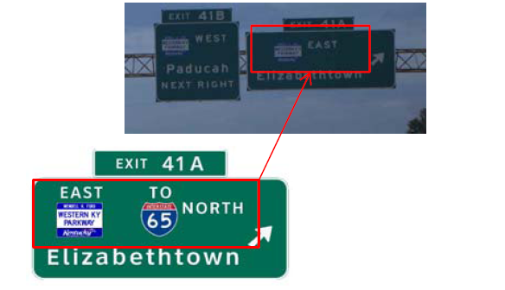
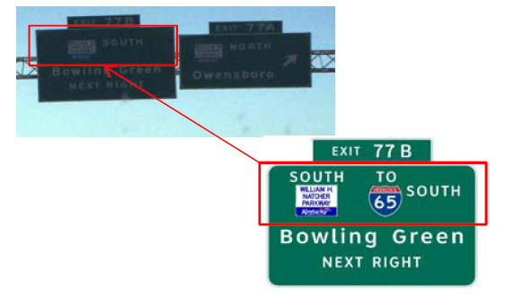
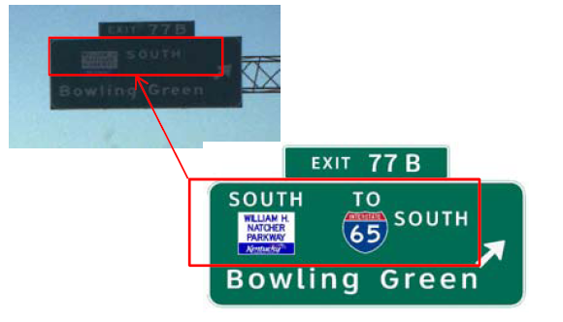
Proposed signing at Natcher Pkwy/WK Pkwy Interchange in District 2 near Central City/Beaver Dam

Slide 10
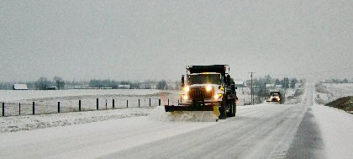
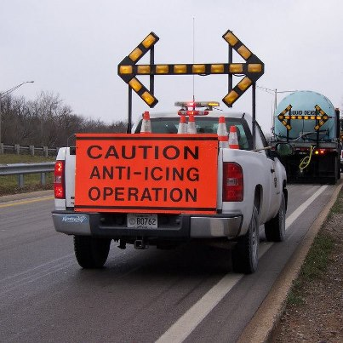
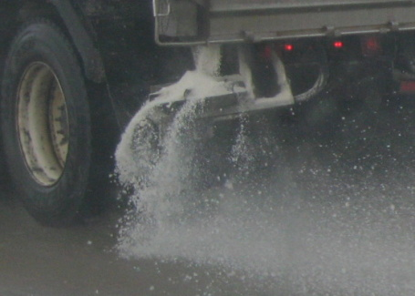
Snow and Ice Operations in D3 Stacey Beason

Slide 11
Preventative Measures
KYTC uses three different types of salt compounds on roadways to help prevent snow and ice build up during a storm. Each adds a different level of protection for the traveling public ...
Road salt. Sodium chloride (NaCl), which is applied by truck-borne spreaders in coarse layers, is much like the common driveway salt. It reacts with water and wet snow, and lowers the freezing point of the resulting liquid. It sort of melts snow and keeps it from "sticking" on roadways, at least while temperatures are moderately cold.
Calcium chloride. Below certain temperatures, plain road salt becomes less effective so crews add liquid calcium chloride (CaCl) to the salt. The resulting mixture keeps snow from sticking on roadways at even colder temperatures.
Brine, or saltwater, is applied while roadways are dry. It's those parallel "lines" you see on pavement sometimes. Brine sticks to the road surface, ready to work when precipitation begins. Crews begin treatment in advance of a storm because anti-icing prevents the bonding of snow and ice to pavement

Slide 12
War Room Operations 270 746 7898
Monitor pavement temperatures and weather conditions
Involves 2 KYTC employees staffed/on call during inclement weather
Backups available
Access to message boards
Serves as central command center for each county in D3
Update KYTC Central Office (TOC) on road conditions every hour
Each KYTC District has one
If you spot icy patches on bridges or roadways, call D.O. main number 270 746 7898 and trucks will be sent out to address the issue

Slide 13
Route Priority Maps
http://transportation.ky.gov/maintenance/pages/snow-and-ice-priority-maps.aspx
Or Google search KYTC Snow and Ice Maps

Slide 14
TS Contract Trucks Warren/Simpson (not available online)

Slide 15
TS Contract Trucks Barren/Metcalfe

Slide 16
University of Kentucky Transportation Center Research Updates Jennifer Walton, P.E.

Slide 17
SHRP II Training Update Tony Young, FHWA

Slide 18
Electric Vehicle Safety
Offered by National Fire Protection Association
Almost 14 million electric cars will be on the world’s roadways within 5 years
Unique Challenges associated with EV’s
2-hr course $17.00 to $19.00 a person
Emergency Field Guide Available around $50
First manual for instructors was published in 1993

Slide 19
List of Hybrid Vehicles in 2010
Honda Civic Hybrid
Honda Insight
Lexus GS, HS
Chevy Malibu Hybrid
Mercury Milan Hybrid
Ford Fusion Hybrid
Nissan Altima Hybrid
Toyota Camry Hybrid
Toyota Prius
Mercedes S400 Hybrid
Cadillac Escalade Hybrid
Chevy Tahoe Hybrid
Ford Escape Hybrid
GMC Yukon Hybrid
Lexus RX
Mazda Tribute Hybrid
Mercury Mariner Hybrid
Toyota Highlander Hybrid
Chevy Silverado Hybrid
GMC Sierra Hybrid
Saturn Vue, Aura

Slide 20
GM Service Technical College provides First Responder Guides (FRG) and Quick Reference (QR) Sheets free of charge to First Responders. FRGs and QRs can be displayed in a classroom as long as they are represented as GM information and are not modified in any way. GM’s First Responder Guides are available at www.gmstc.com

Slide 21
E-Assist Vehicles
Vehicles which store power as the driver applies the brakes
Standard in the 2013 Buick Regal
2012 Buick Lacross
2013 Chevy Malibu Eco uses exterior badging
2014 Chevy Equinox

Slide 22
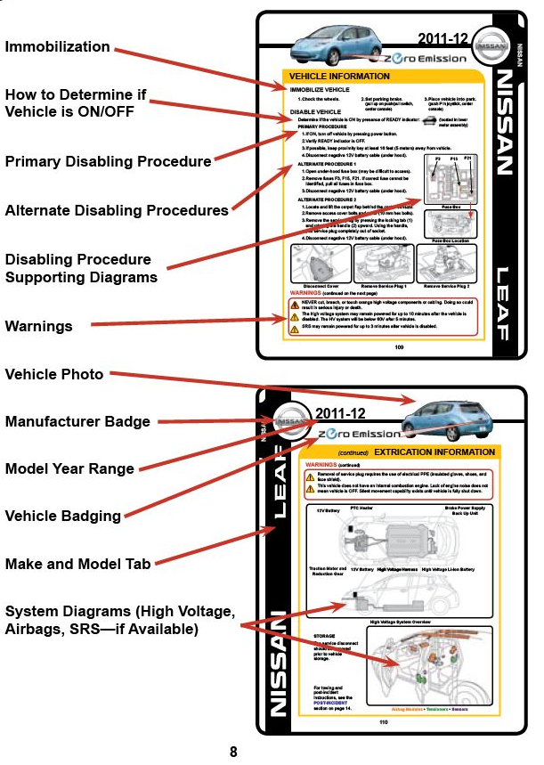
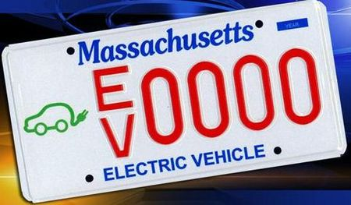
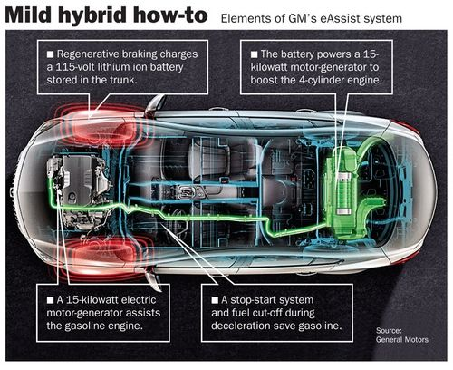

Slide 23
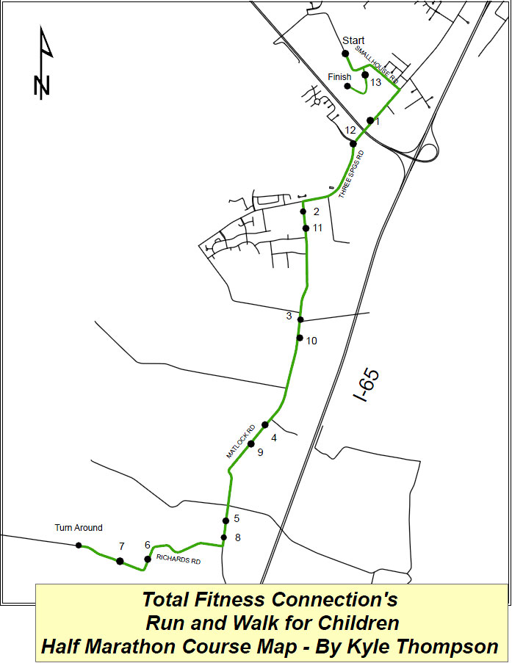
Construction/Parades/Marathons
Widening of I-65 Update
17th annual Total Fitness Connection Marathon 3/23/13

Slide 24
Conclusions
Kentucky Lifesaver’s Conference is not in April this year
When? August 5-7 2013 (Mon-Wed)
Where? Louisville Marriott Downtown
Costs only $150-$200 and food is provided

Slide 25
Who Should Attend Lifesavers?
Community traffic safety programs
Injury prevention programs
Prosecutors and judges involved in traffic safety issues
State and local law enforcement
Federal and state highway safety agencies
State and local emergency medical services, and public health
Child passenger safety professionals
Thank you for coming!
Next meeting will be in June

